Slide 1
Exploration of Used Cars Markets

Slide 2
Part I: Data cleaning

Slide 3
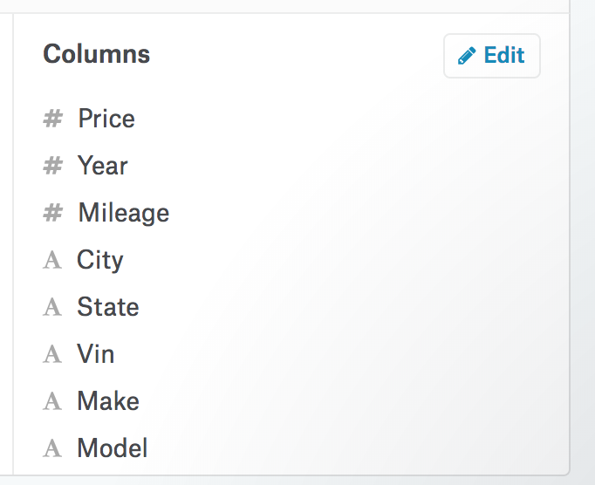
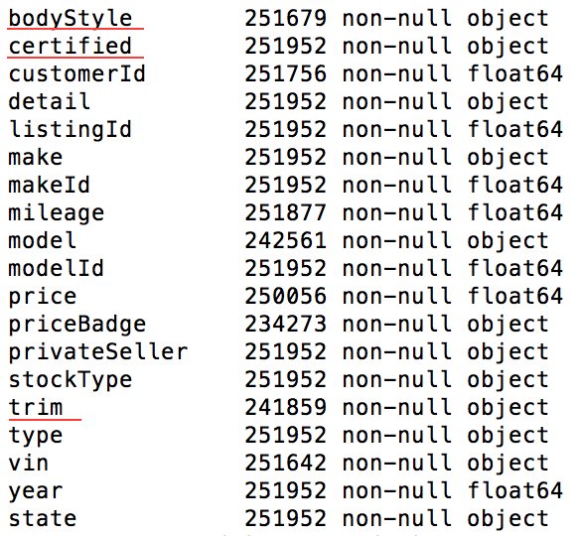
Dirty Datasets:
Cars.com-270k records
Scripted by zip code
TrueCar.com-1.2 Million records
Kaggle

Slide 4
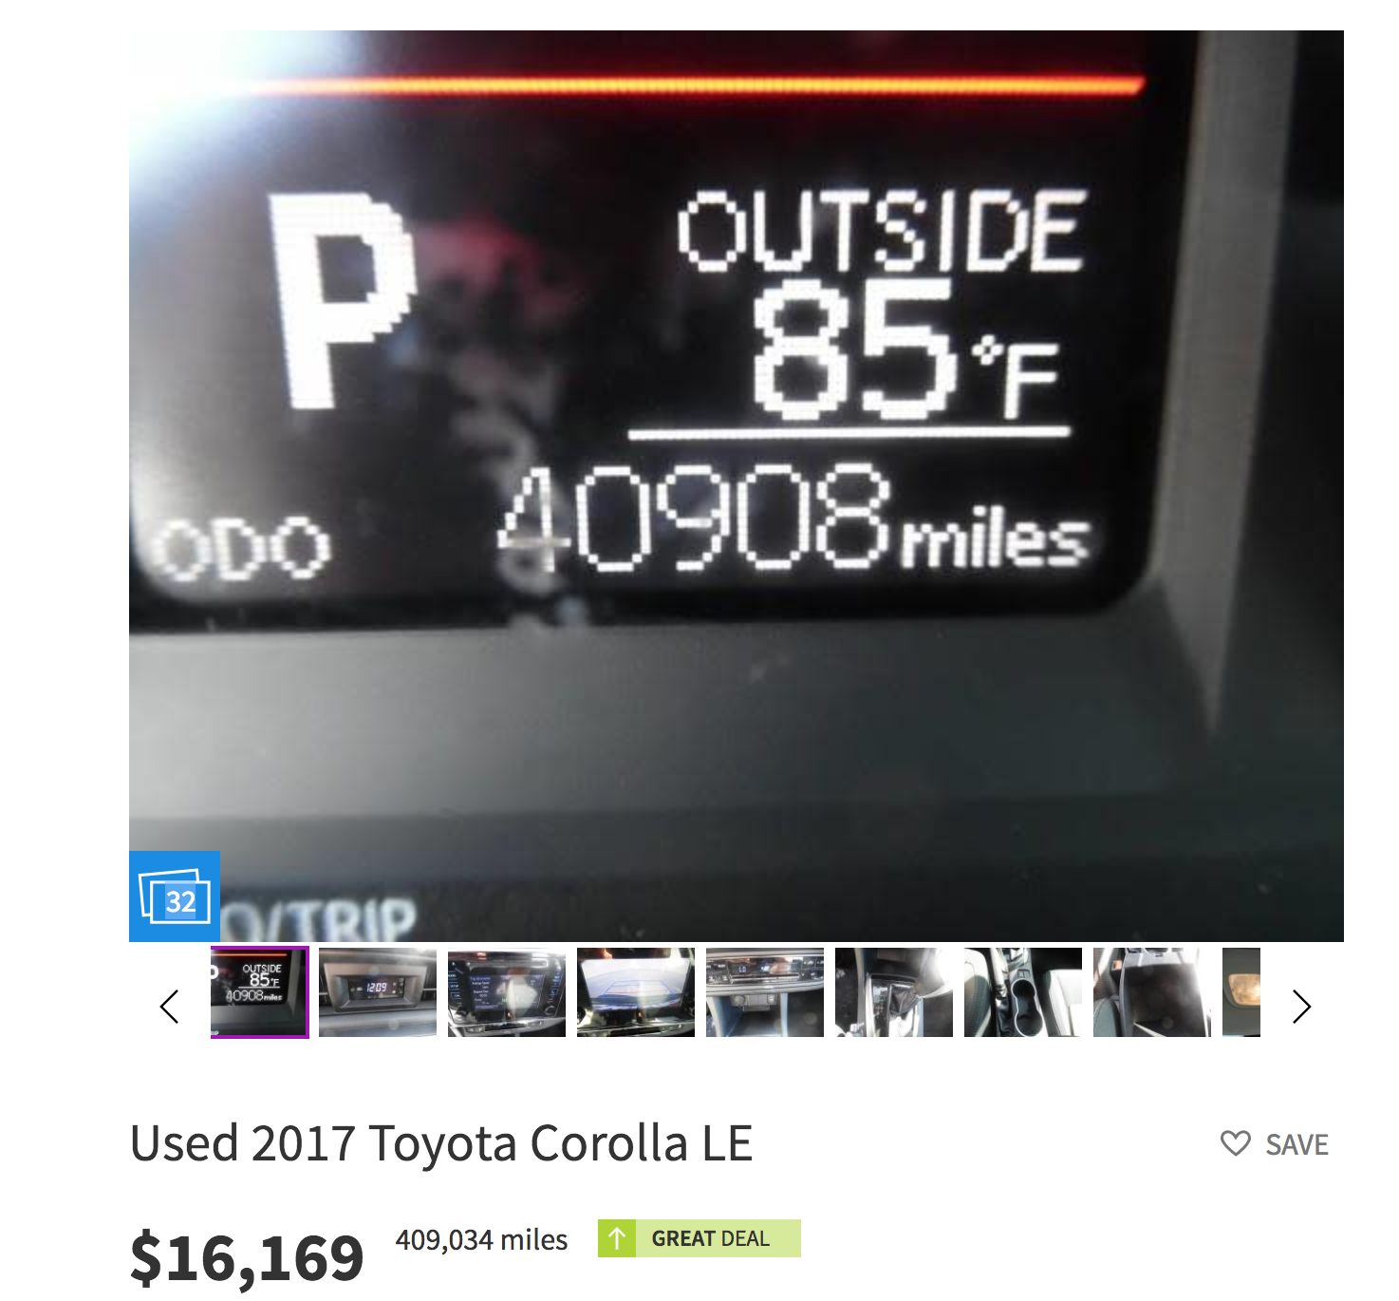
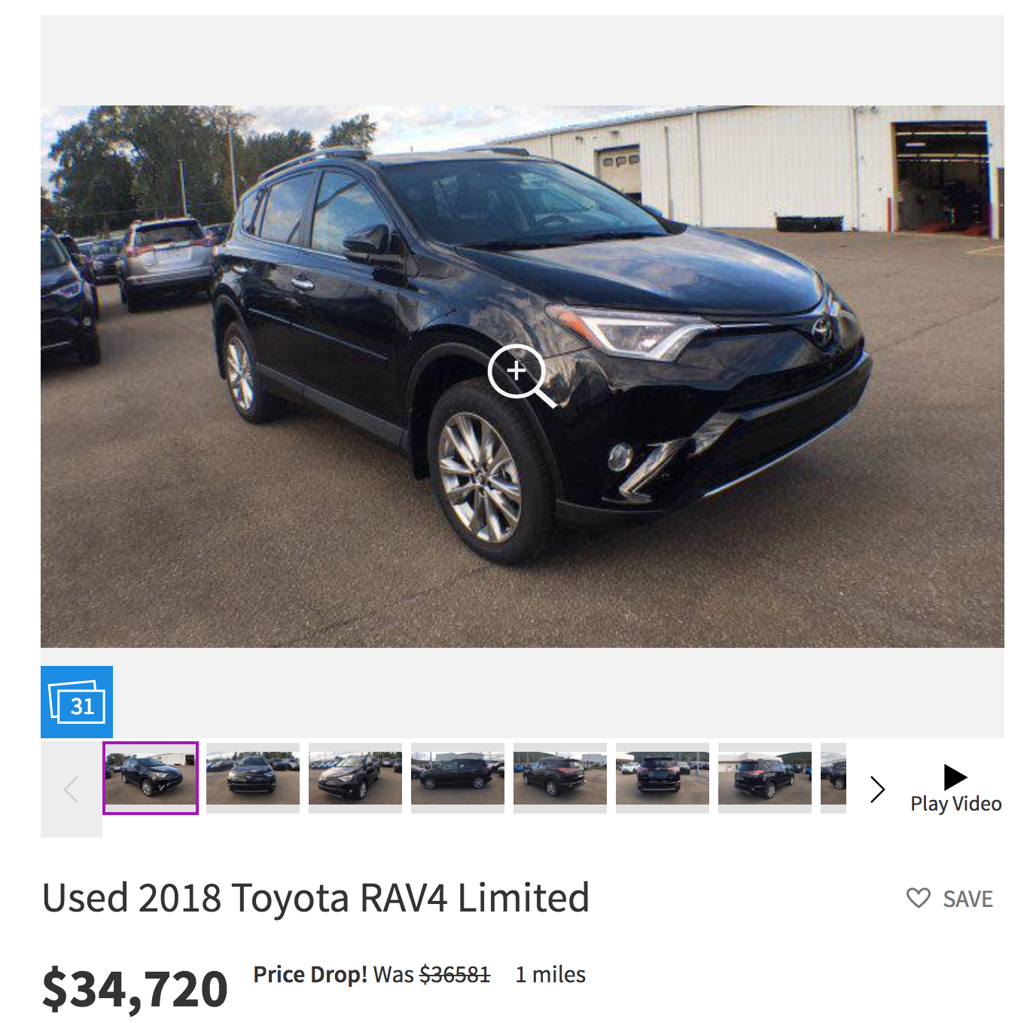
Car.com Dataset
Mileage problem is the most frequent problem
Unconsciously high
Insanely low

Slide 5
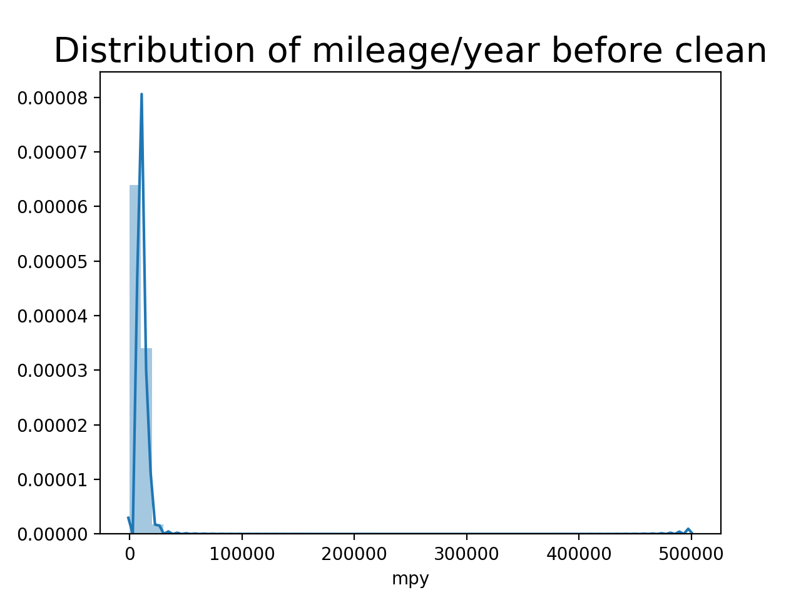
Car.com Dataset
New feature MPY
Reason
Cleaning process
For mileage<1000
For MPY>Q3+1.5(Q3-Q1)

Slide 6
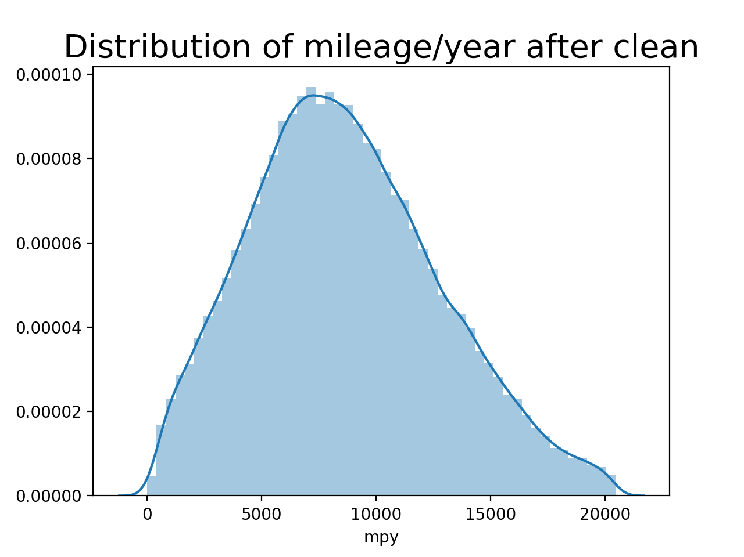
Car.com Dataset

Slide 7
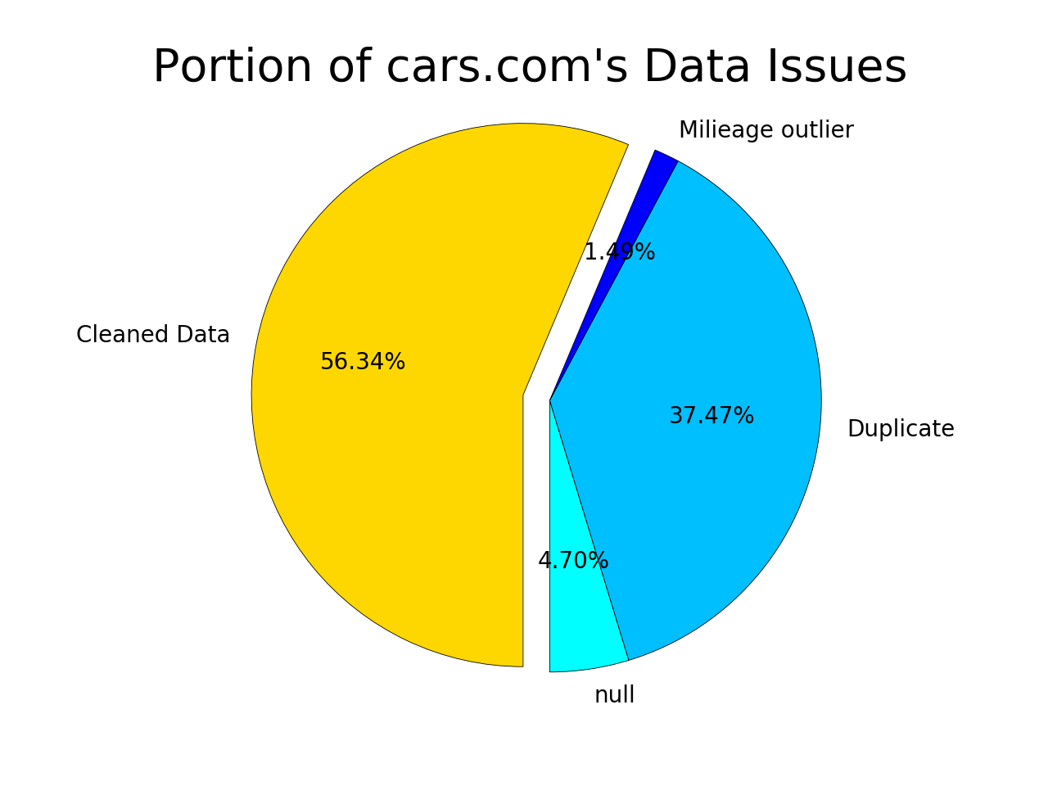

Slide 8
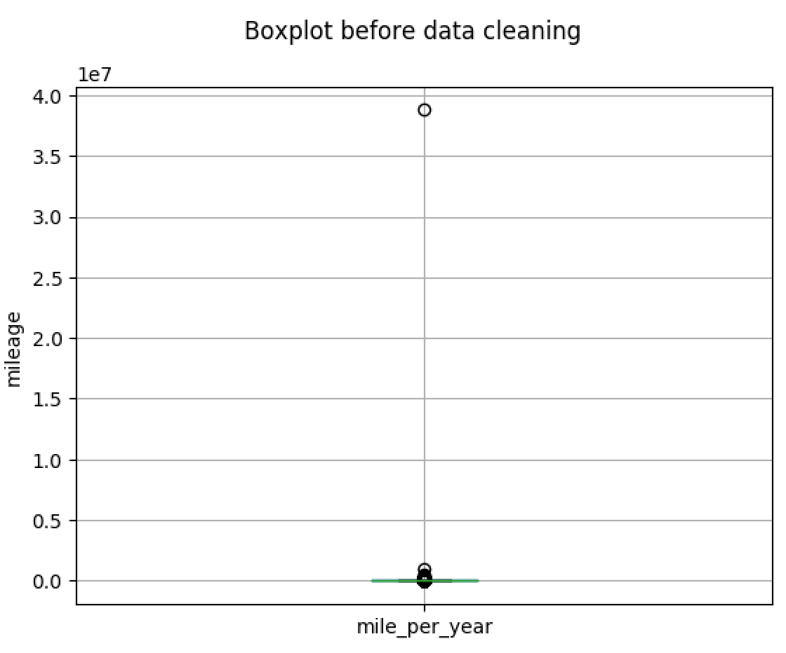
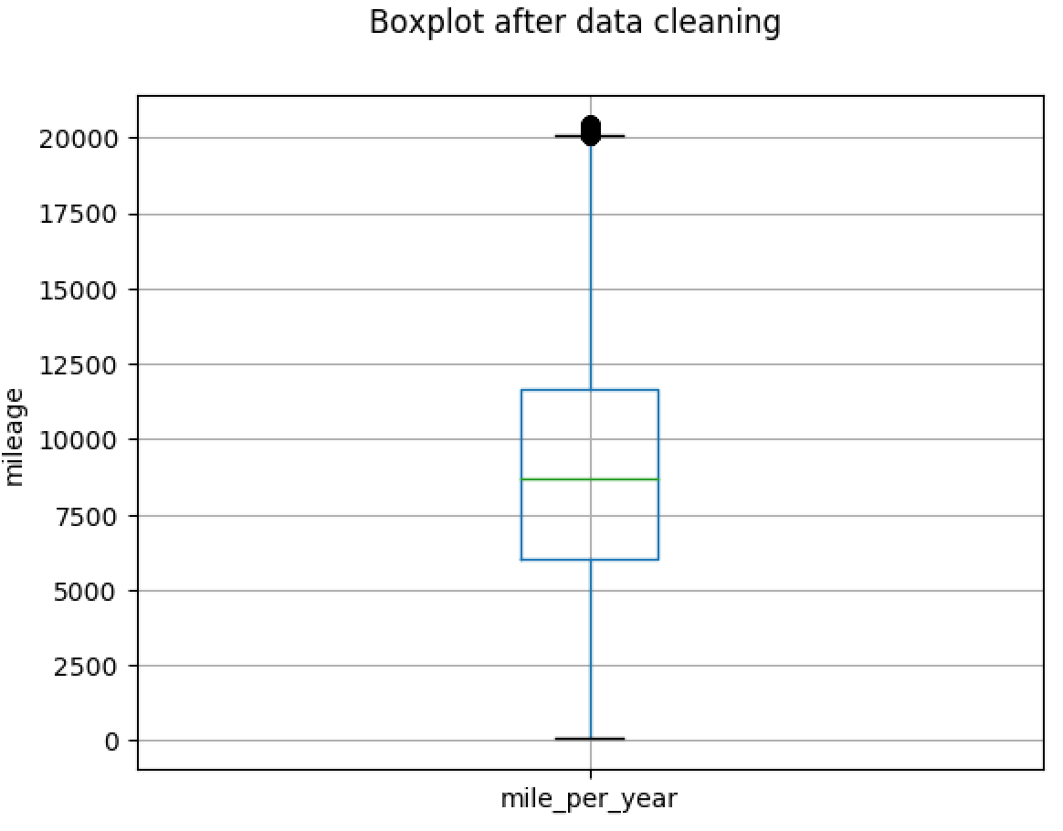
TrueCar.com Dataset
The boxplot to identify outliers for unreasonable mileage

Slide 9
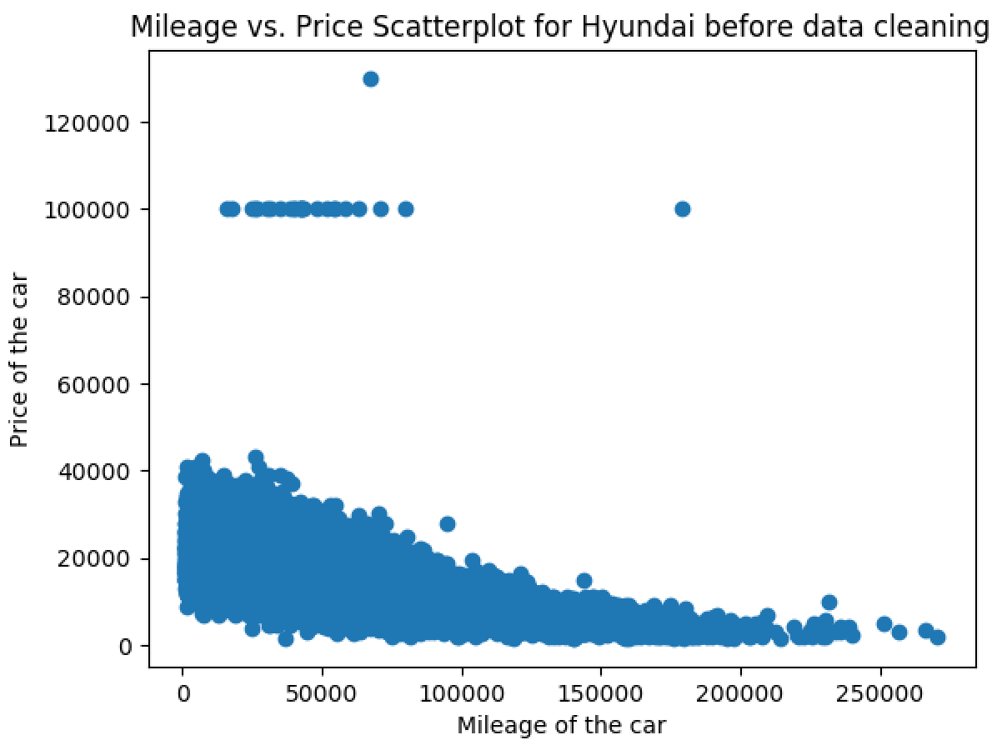
TrueCar.com Dataset
The scatterplot to identify noise value
Hyundai Price Range of a New Car: $15000 to $40000
Overpriced Used cars

Slide 10
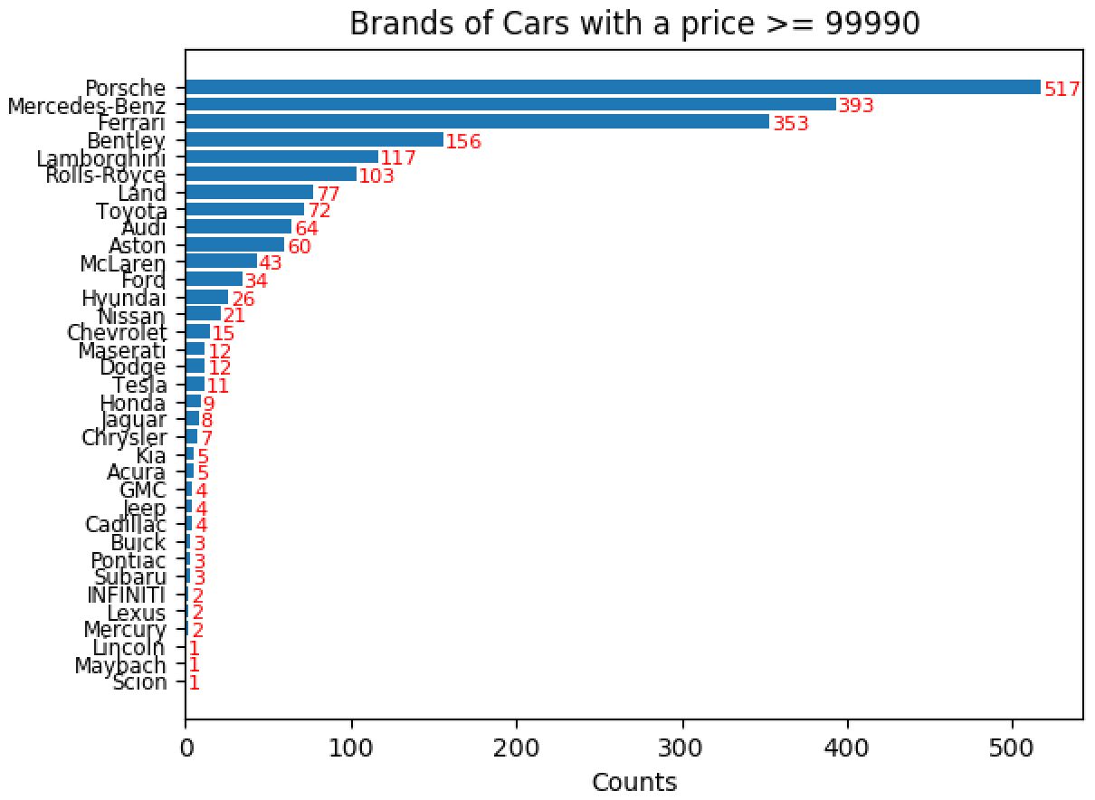
TrueCar.com Dataset
The bar chart for expensive car brands
Luxury car brands: Porsche, Mercedes, Ferrari etc.
All-level car brands: Nissan, Ford, Lexus etc
Economic car brands: Toyota, Honda, Hyundai etc.

Slide 11
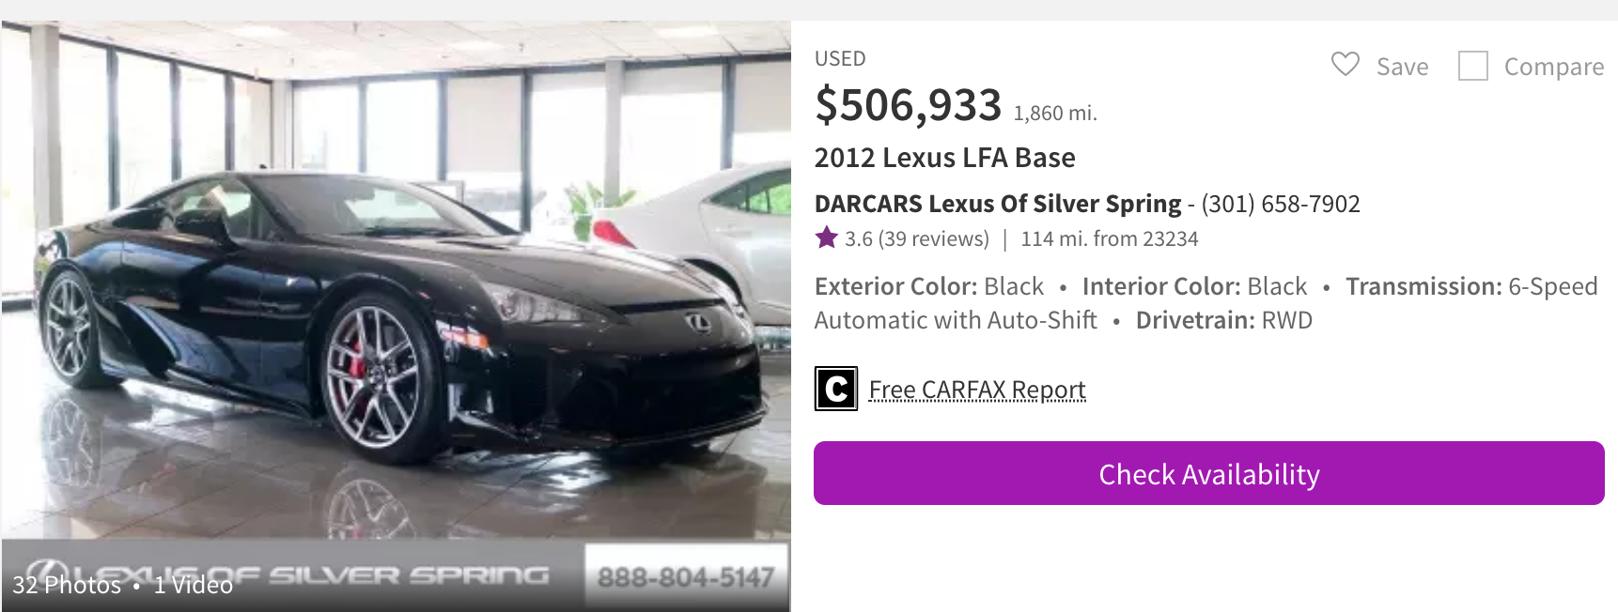
TrueCar.com Dataset
All-level car brands: Nissan, Ford, Lexus etc

Slide 12
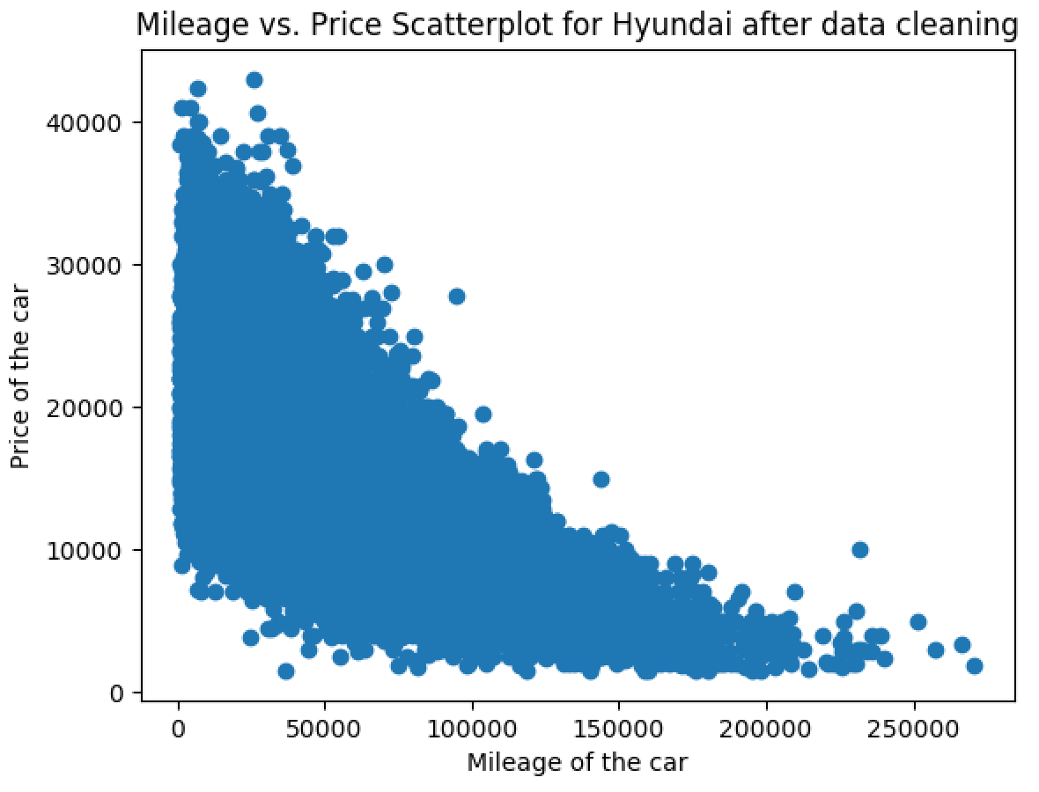
TrueCar.com Dataset
The scatterplot to identify noise value

Slide 13
Part II: EDA
1.Trade Volume & Price Patterns
2.Analysis of used cars trade by Geography
3.Comparison of cars in the same level and category

Slide 14
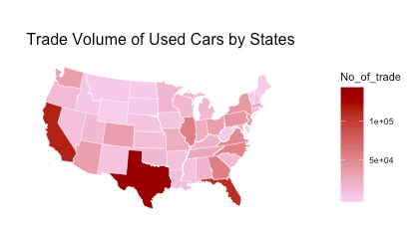
Which States have more used cars trade?
Used cars trade volume in CA, TX, FL are the top 3 in US. This is consistent with new car sales in US.
Trade in east coast is generally higher than the rest states.

Slide 15
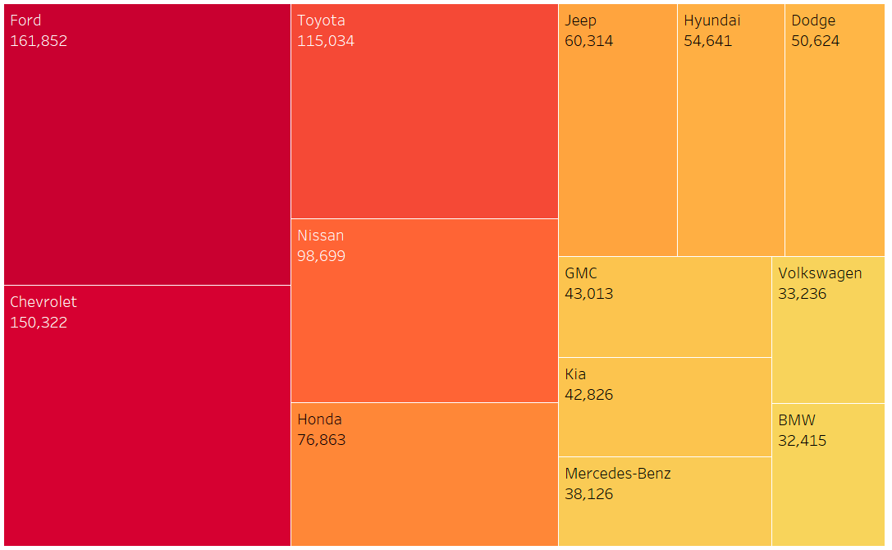
Which brands are most active in used cars trade?

Slide 16
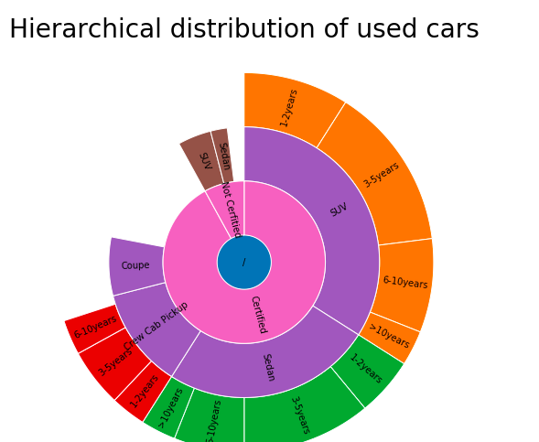
Features of cars
Certified cars are dominating the used cars market, with 92% market share.
SUV, Sedan are most popular style, taking up over 50% of the total market.
Most used cars has been used for less than 5 years. Very few are over 10 years.

Slide 17
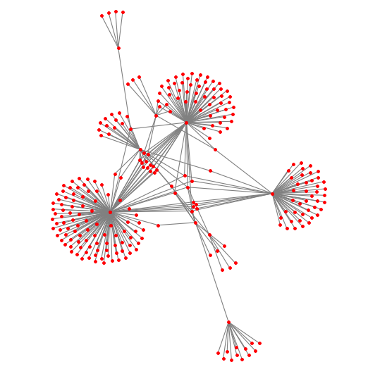
Agents are main players in used cars trade
Networks of agents of the top 10 popular used cars
Most agents only sell one brand. Them are a few agents working with a couple of popular brands.
Note: Top 10 car maker and agents with trade amount over 20.

Slide 18
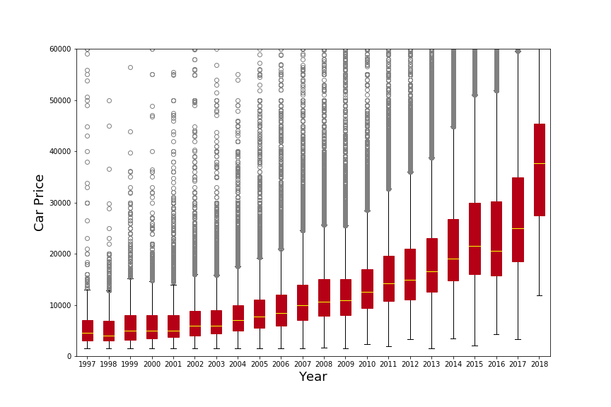
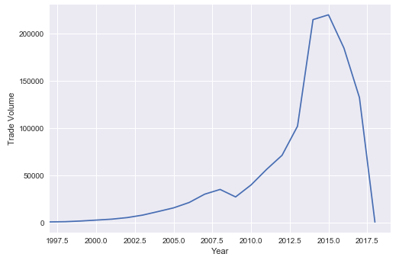
New generation cars have higher market value
Price and Volume distribution over cars’ registration year
The distribution of New generation cars are higher, especially for those registered in 2018.
Most used cars in the market registered between 2013-2016

Slide 19
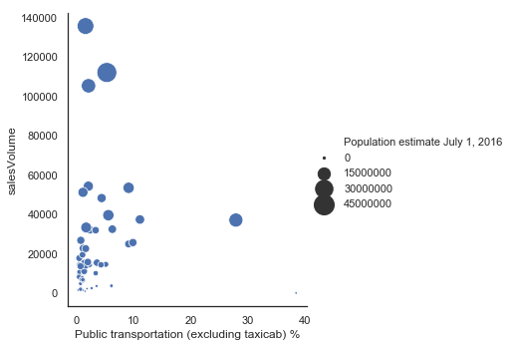
Sales Volume vs State Population vs Public Transportation
TX
States with larger population tend to have greater sales volume: TX, CA, FL
The percentage of workers who take public transportation has little relationship with the sales volume of used cars.
A great percentage of workers in New York and DC use public transportation.
CA
FL
NY
DC

Slide 20
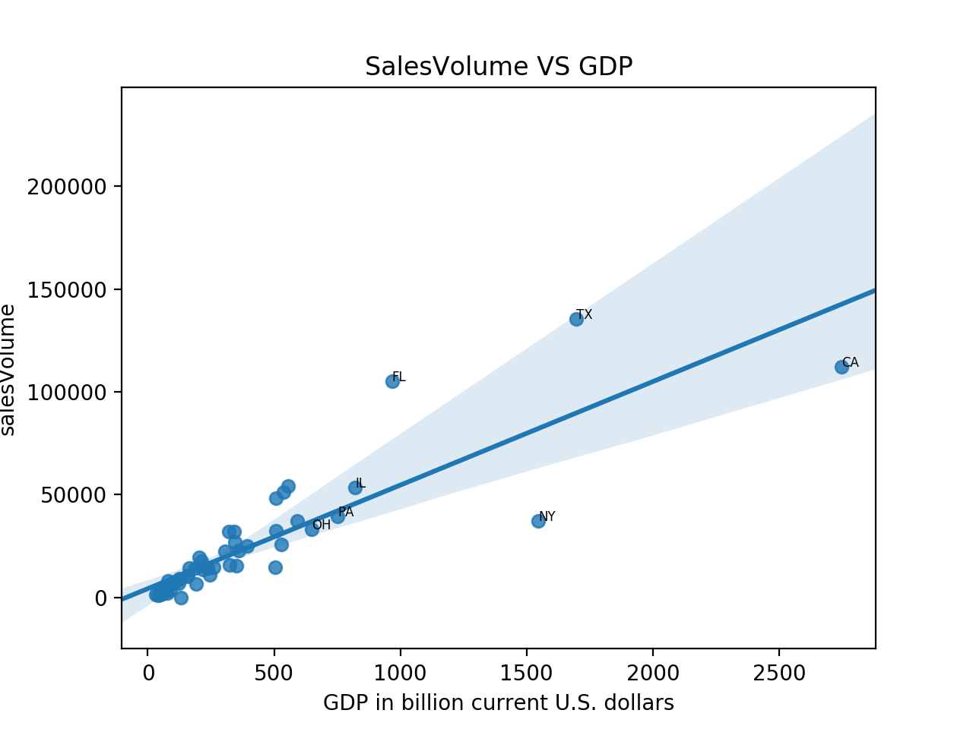
Sales Volume vs State GDP
The sales volume of used cars is positively related with the GDP.
Note that GDP is positively related to population.
The linear regression: p-value < 0.0001
The line indicates the regression line.

Slide 21
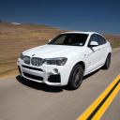
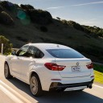
Compare Different Types of Vehicles
4 groups/12 models
Mercedes-Benz S-ClassS350 $89900
BMW 7 $83100
Porsche Panamera4dr $85000
Mercedes-Benz GL-ClassGL450 $69550
BMW X6xDrive35i $62950
Porsche CayenneAWD $65700
Toyota CamryLE $23645
Honda AccordLX $23570
Nissan Altima2.5 $23260
Toyota RAV4LE $24660
Honda CR-VLX $24250
Nissan RogueS $24800

Slide 22
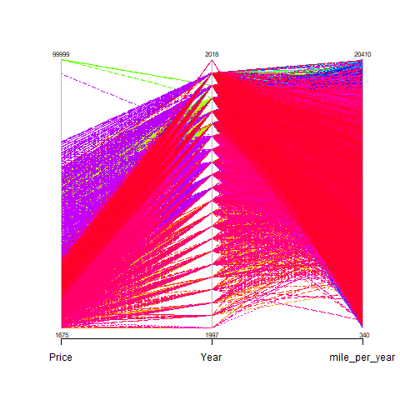
Relationships among Three Variables
Newer Model ~ Higher Price
Higher Miles-per-Year ~ Lower Price

Slide 23
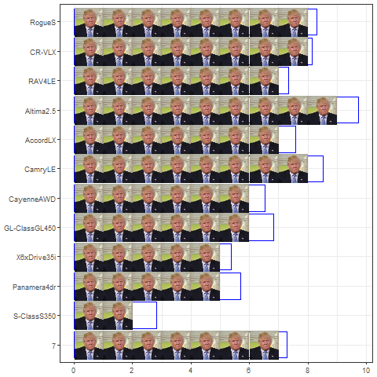
Evaluation of Sales Volume
Within Classes
Across Classes

Slide 24
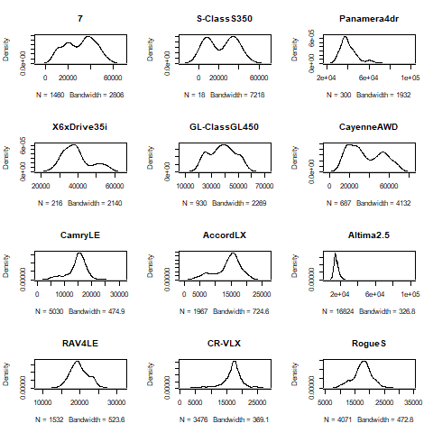
Distribution of Used Cars’ Prices
Rank All Vehicles
within Groups
based on Prices
Similar
Rank All Vehicles
among Groups
based on Prices
EC>ES>CS>CC

Slide 25
Thank You!

